Slide 1

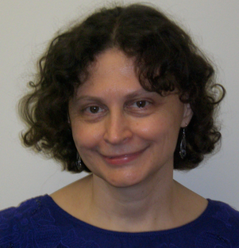


Separations above TFNP from Sherali-Adams Lower Bounds
Noah Fleming | Anna Gál | Deniz Imrek | Christophe Marciot
Lund & Columbia | UT Austin | UT Austin | Lund University

Slide 2
TFNP
Total search problems with efficient verifiers
Example: $f:\left[n\right]→\left[n−1\right]$, find a collision
$$f\left(i\right)=f(j)$$
Every input has a solution
An input can have multiple solutions
Solutions can be verified by efficient decision trees

Slide 3

TF$Σ_{2}$ [Kleinberg, Korten, Mitropolsky, Papadimitriou’21]
Total search problems with $coNP$verifiers
Example: $f:\left[n\right]→\left[n+1\right]$, find an element not in the range
$$∀x f\left(x\right)≠y$$
Every input has a solution
An input can have multiple solutions
Solutions can be verified by checking a forall of efficient decision trees

Slide 4
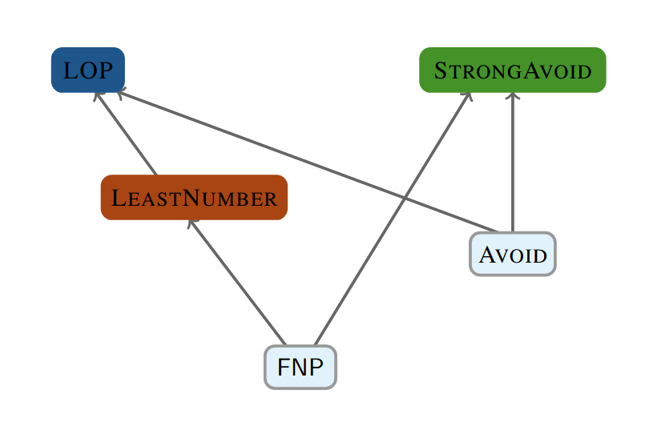
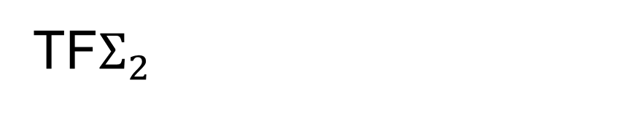
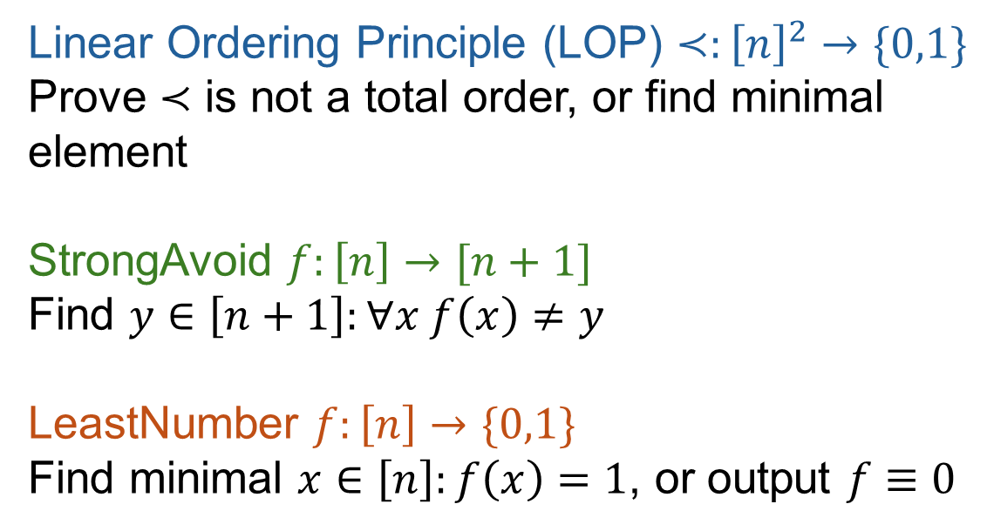
TF$Σ_{2}$
Linear Ordering Principle (LOP) $≺:{\left[n\right]}^{2}→\{0,1\}$
Prove $≺$ is not a total order, or find minimal element
StrongAvoid $f:\left[n\right]→[n+1]$
Find $y∈\left[n+1\right]:∀x f\left(x\right)≠y$
LeastNumber $f:\left[n\right]→\{0,1\}$
Find minimal $x∈\left[n\right]:f\left(x\right)=1$, or output $f≡0$

Slide 5
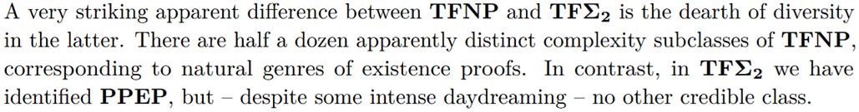
TF$Σ_{2}$
Lack of diversity in problems
  Every problem defined in [KKMP21] reduces to StrongAvoid
PPEP=Class of StrongAvoid

Slide 6
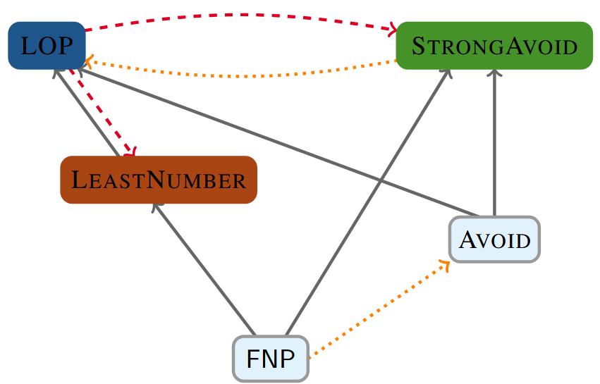
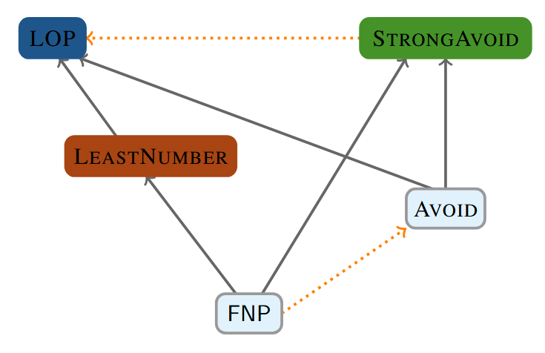
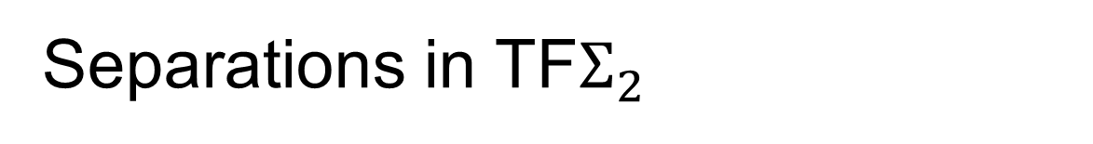
Separations in TF$Σ_{2}$
[Korten, Pitassi’24]
[KP24]
[FGJ+26]
[Fleming, Grosser, Jain, Li, Ren, Shirley, Yuan’26]

Slide 7
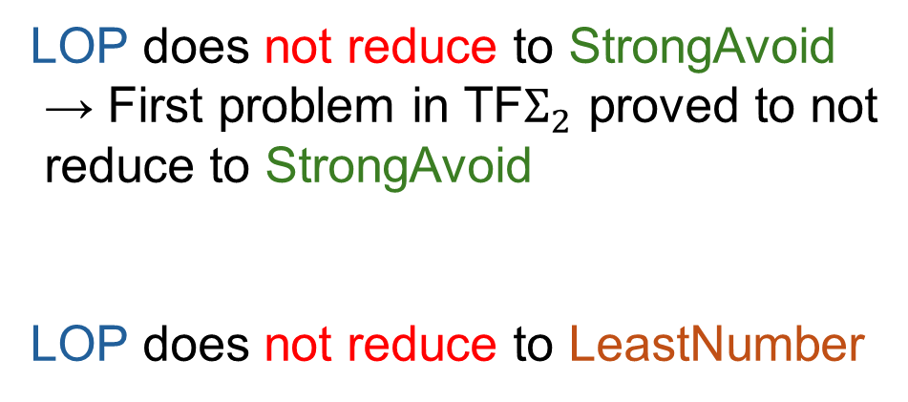
Our results
[KP24]
LOP does not reduce to StrongAvoid
→ First problem in TF$Σ_{2}$ proved to not
reduce to StrongAvoid
LOP does not reduce to LeastNumber
[FGJ+26]

Slide 8
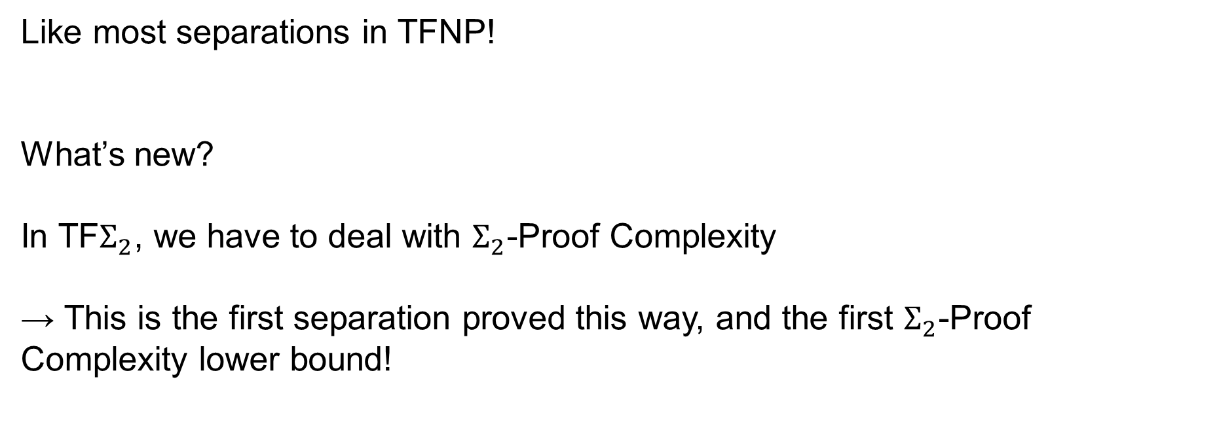
Tool: Proof Complexity
Like most separations in TFNP!
What’s new?
In TF$Σ_{2}$, we have to deal with $Σ_{2}$-Proof Complexity
→ This is the first separation proved this way, and the first $Σ_{2}$-Proof Complexity lower bound!

Slide 9
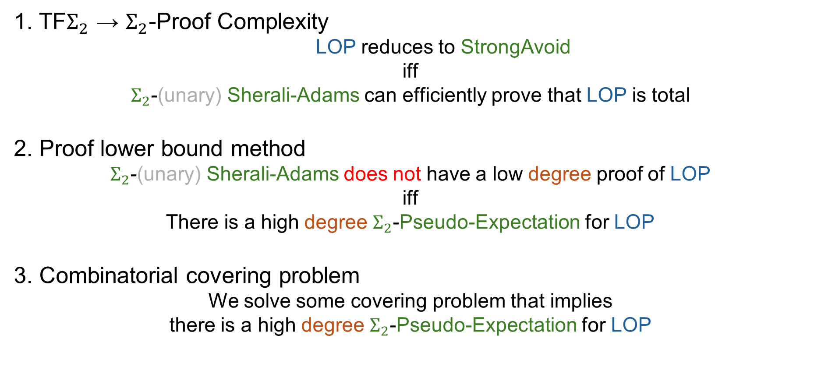
How our proof works
1. TF$Σ_{2}$ → $Σ_{2}$-Proof Complexity
LOP reduces to StrongAvoid
iff
$Σ_{2}$-(unary) Sherali-Adams can efficiently prove that LOP is total
2. Proof lower bound method
$Σ_{2}$-(unary) Sherali-Adams does not have a low degree proof of LOP
iff
There is a high degree $Σ_{2}$-Pseudo-Expectation for LOP
3. Combinatorial covering problem
We solve some covering problem that implies
there is a high degree $Σ_{2}$-Pseudo-Expectation for LOP

Slide 10
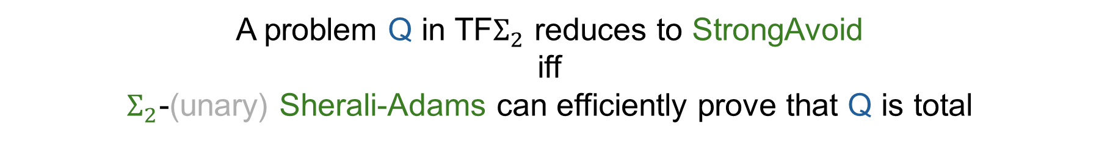
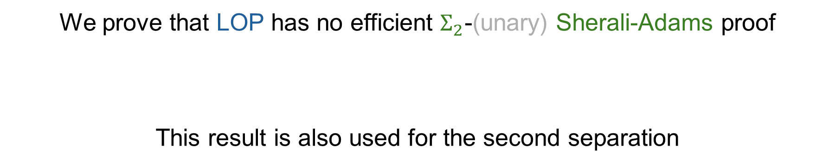
Tool: $Σ_{2}$-Proof Complexity [Fleming, I., Marciot’25]
A problem Q in TF$Σ_{2}$ reduces to StrongAvoid
iff
$Σ_{2}$-(unary) Sherali-Adams can efficiently prove that Q is total
We prove that LOP has no efficient $Σ_{2}$-(unary) Sherali-Adams proof
This result is also used for the second separation

Slide 11
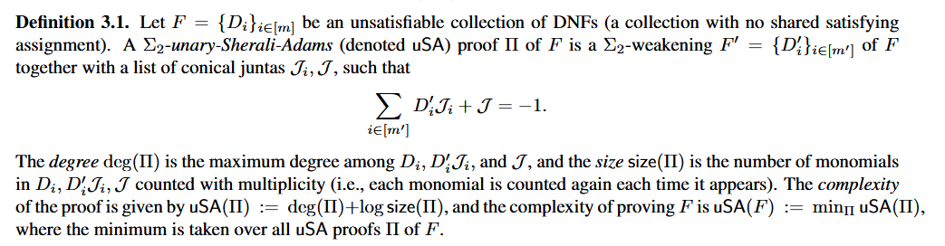
What is a proof (for a proof system)?
Given an unsatisfiable logical formula, a proof is an efficiently verifiable deduction, using only some specific (to the proof system) rules, that concludes with a contradiction

Slide 12
What is a proof (for a proof system)?
Given an unsatisfiable logical formula, a proof is an efficiently verifiable deduction, using only some specific (to the proof system) rules, that concludes with a contradiction
What’s important to remember for this talk:
We want to lower bound the complexity of (unary) Sherali-Adams proofs
Sherali-Adams treats formulas as polynomial inequalities and a proof is simply a collection of polynomials
The degree is a lower bound on the complexity

Slide 13
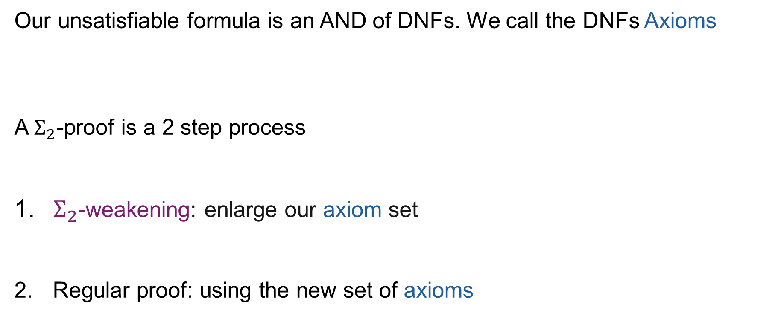
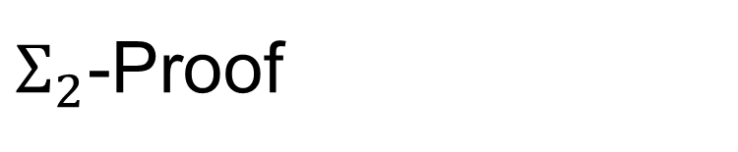
$Σ_{2}$-Proof
Our unsatisfiable formula is an AND of DNFs. We call the DNFs Axioms
A $Σ_{2}$-proof is a 2 step process
$Σ_{2}$-weakening: enlarge our axiom set
Regular proof: using the new set of axioms

Slide 14
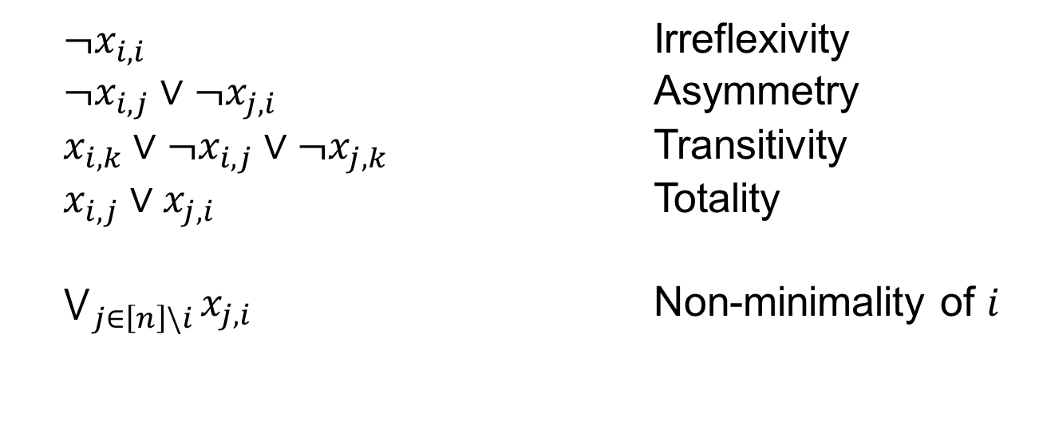

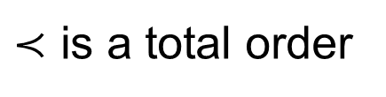
“LOP is total” as an unsatisfiable formula
Variable $x_{i,j}=1$ indicates $i≺j$ in purported order
For all distinct $i,j,k∈\left[n\right]$
$¬x_{i,i}$ Irreflexivity
$¬x_{i,j}∨¬x_{j,i}$ Asymmetry
$x_{i,k}∨¬x_{i,j}∨¬x_{j,k}$ Transitivity
$x_{i,j}∨x_{j,i}$ Totality
$\bigvee_{j∈\left[n\right]\backslash i}{x_{j,i}}$ Non-minimality of $i$
$≺$ is a total order
Think of those as DNFs with terms of size 1!

Slide 15
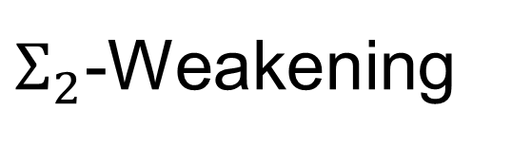
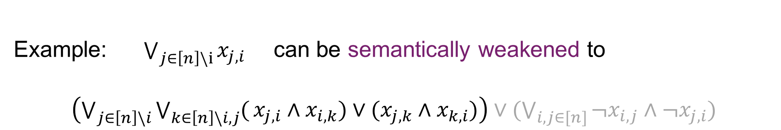
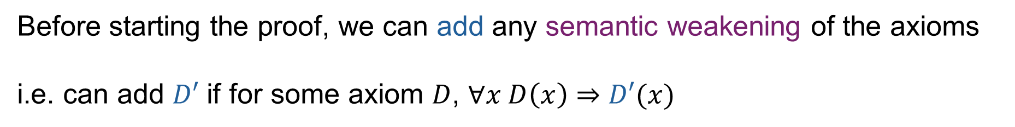
$Σ_{2}$-Weakening
Before starting the proof, we can add any semantic weakening of the axioms
i.e. can add $D′$ if for some axiom $D$, $∀x D\left(x\right)⇒D′(x)$
Example: $\bigvee_{j∈\left[n\right]\backslash i}{x_{j,i}}$ can be semantically weakened to
$\left(\bigvee_{j∈\left[n\right]\backslash i}{\bigvee_{k∈\left[n\right]\backslash i,j}{(}x_{j,i}∧x_{i,k})∨(x_{j,k}∧x_{k,i})}\right)∨(\bigvee_{i,j∈[n]}{¬x_{i,j}∧¬x_{j,i})}$
Could be in a very complicated form!
But must be a DNF

Slide 16
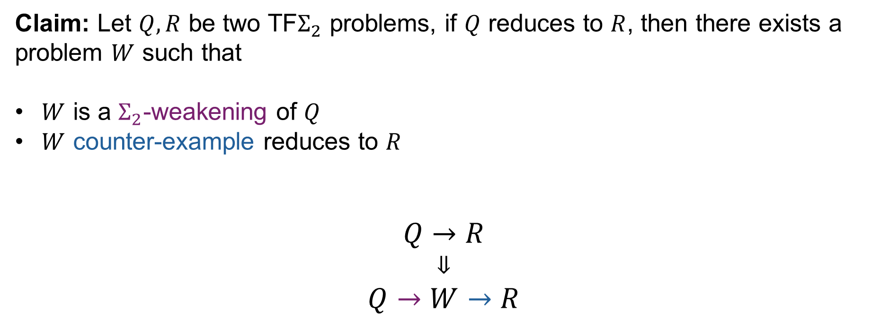
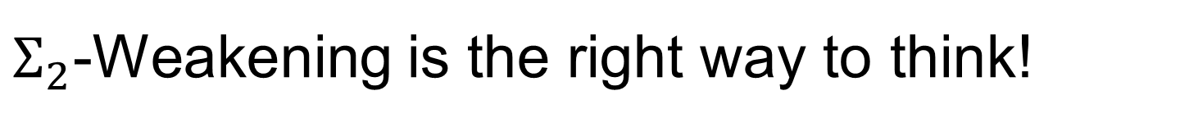
$Σ_{2}$-Weakening is the right way to think!
Claim: Let $Q, R$ be two TF$Σ_{2}$ problems, if $Q$ reduces to $R$, then there exists a problem $W$ such that
$W$ is a $Σ_{2}$-weakening of $Q$
$W$ counter-example reduces to $R$
$$Q→R$$
$$⇓$$
$$Q→W→R$$
↑ [Thapen’25] very strong type of reduction; happens at the TFNP level
The second separations uses this factorization

Slide 17
How our proof works
We prove that for any $Σ_{2}$-weakening of LOP, there is no low degree Sherali-Adams proof

Slide 18
How our proof works
1. TF$Σ_{2}$ → $Σ_{2}$-Proof Complexity
LOP reduces to StrongAvoid
iff
$Σ_{2}$-(unary) Sherali-Adams can efficiently prove that LOP is total
2. Proof lower bound method
$Σ_{2}$-(unary) Sherali-Adams does not have a low degree proof of LOP
iff
There is a high degree $Σ_{2}$-Pseudo-Expectation for LOP
3. Combinatorial covering problem
We solve some covering problem that implies
there is a high degree $Σ_{2}$-Pseudo-Expectation for LOP

Slide 19
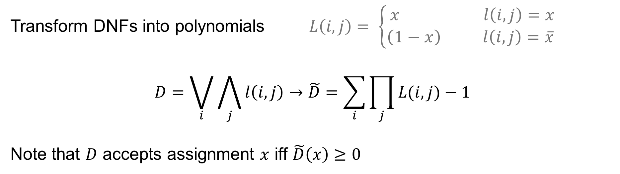
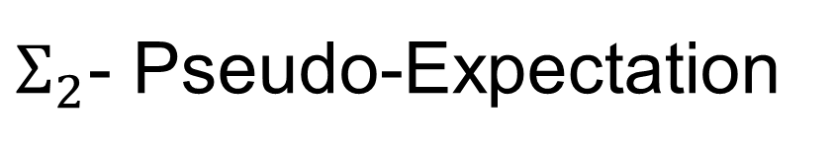
$Σ_{2}$- Pseudo-Expectation
Transform DNFs into polynomials $L\left(i,j\right)= \left\{\begin{aligned}x l\left(i,j\right)=x \\ \left(1−x\right) l\left(i,j\right)=\overline{x} \end{aligned}\right.$
$$D=\bigvee_{i}{\bigwedge_{j}{l\left(i,j\right)}}→\tilde{D}=\sum_{i}{\prod_{j}{L(i,j)}}−1$$
Note that $D$ accepts assignment $x$ iff $\tilde{D}\left(x\right)≥0$

Slide 20
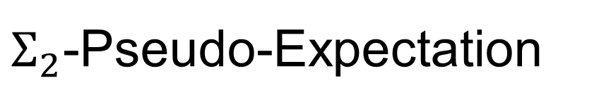
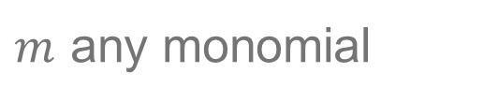
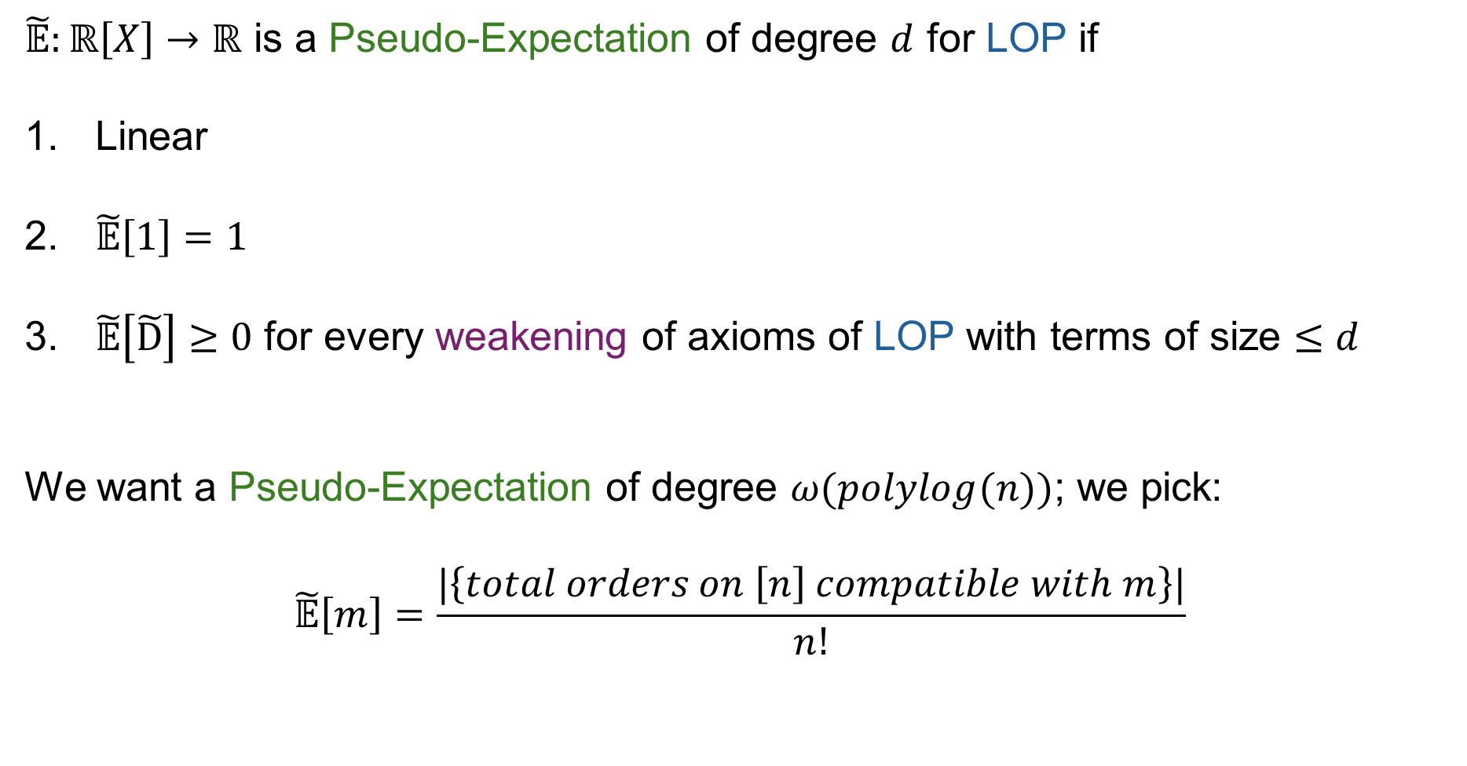
$Σ_{2}$-Pseudo-Expectation
Note: This definition is simplified
$\tilde{𝔼}:ℝ\left[X\right]→ℝ$ is a Pseudo-Expectation of degree $d$ for LOP if
Linear
$\tilde{𝔼}\left[1\right]=1$
$\tilde{𝔼}\left[\tilde{D}\right]≥0$ for every weakening of axioms of LOP with terms of size $≤d$
We want a Pseudo-Expectation of degree $ω(polylog(n))$; we pick:
$$\tilde{𝔼}\left[m\right]=\frac{|\left\{total orders on \left[n\right] compatible with m\right\}|}{n!}$$
$m$ any monomial

Slide 21
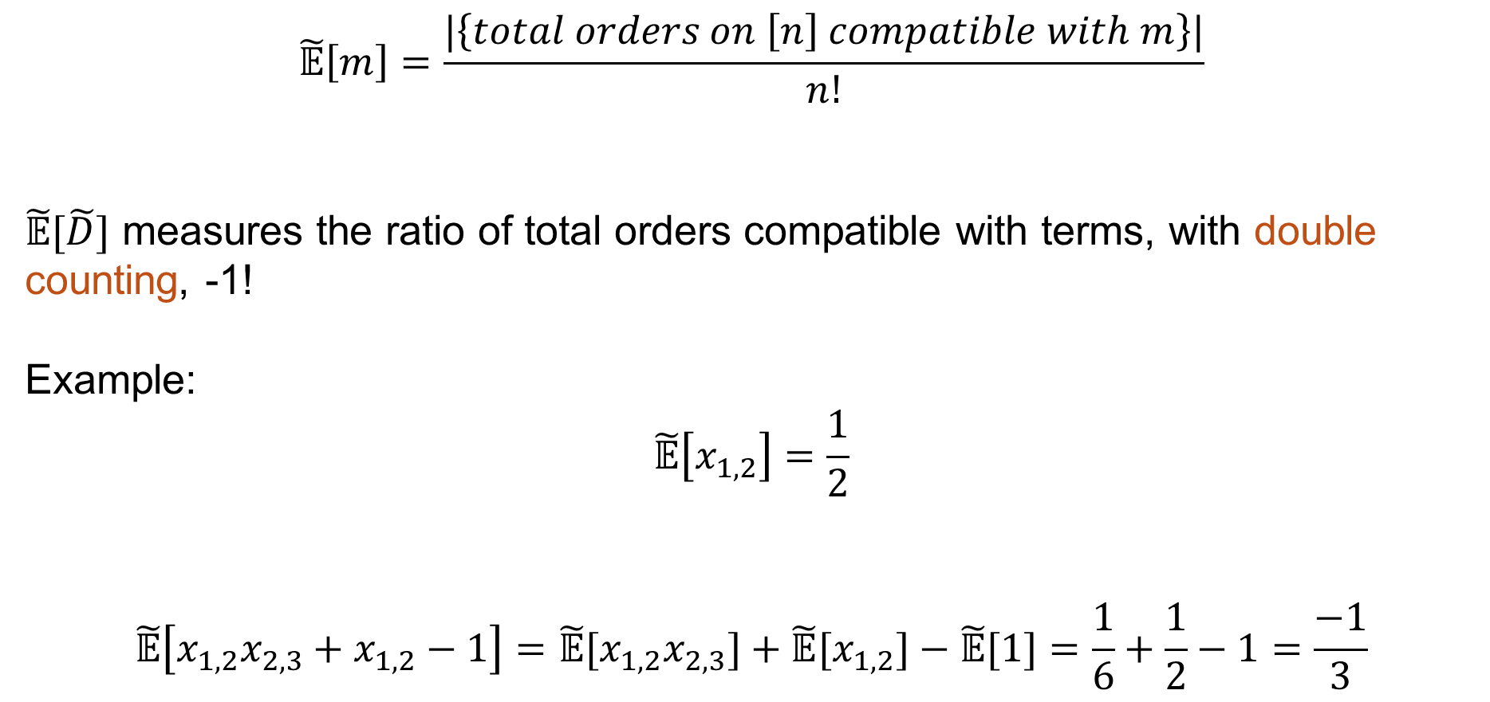
$Σ_{2}$-Pseudo-Expectation
$$\tilde{𝔼}\left[m\right]=\frac{|\left\{total orders on \left[n\right] compatible with m\right\}|}{n!}$$
$\tilde{𝔼}[\tilde{D}]$ measures the ratio of total orders compatible with terms, with double counting, -1!
Example:
$$\tilde{𝔼}\left[x_{1,2}\right]=\frac{1}{2}$$
$$\tilde{𝔼}\left[x_{1,2}x_{2,3}+x_{1,2}−1\right]=\tilde{𝔼}[x_{1,2}x_{2,3}]+\tilde{𝔼}[x_{1,2}]−\tilde{𝔼}[1]=\frac{1}{6}+\frac{1}{2}−1=\frac{−1}{3}$$

Slide 22
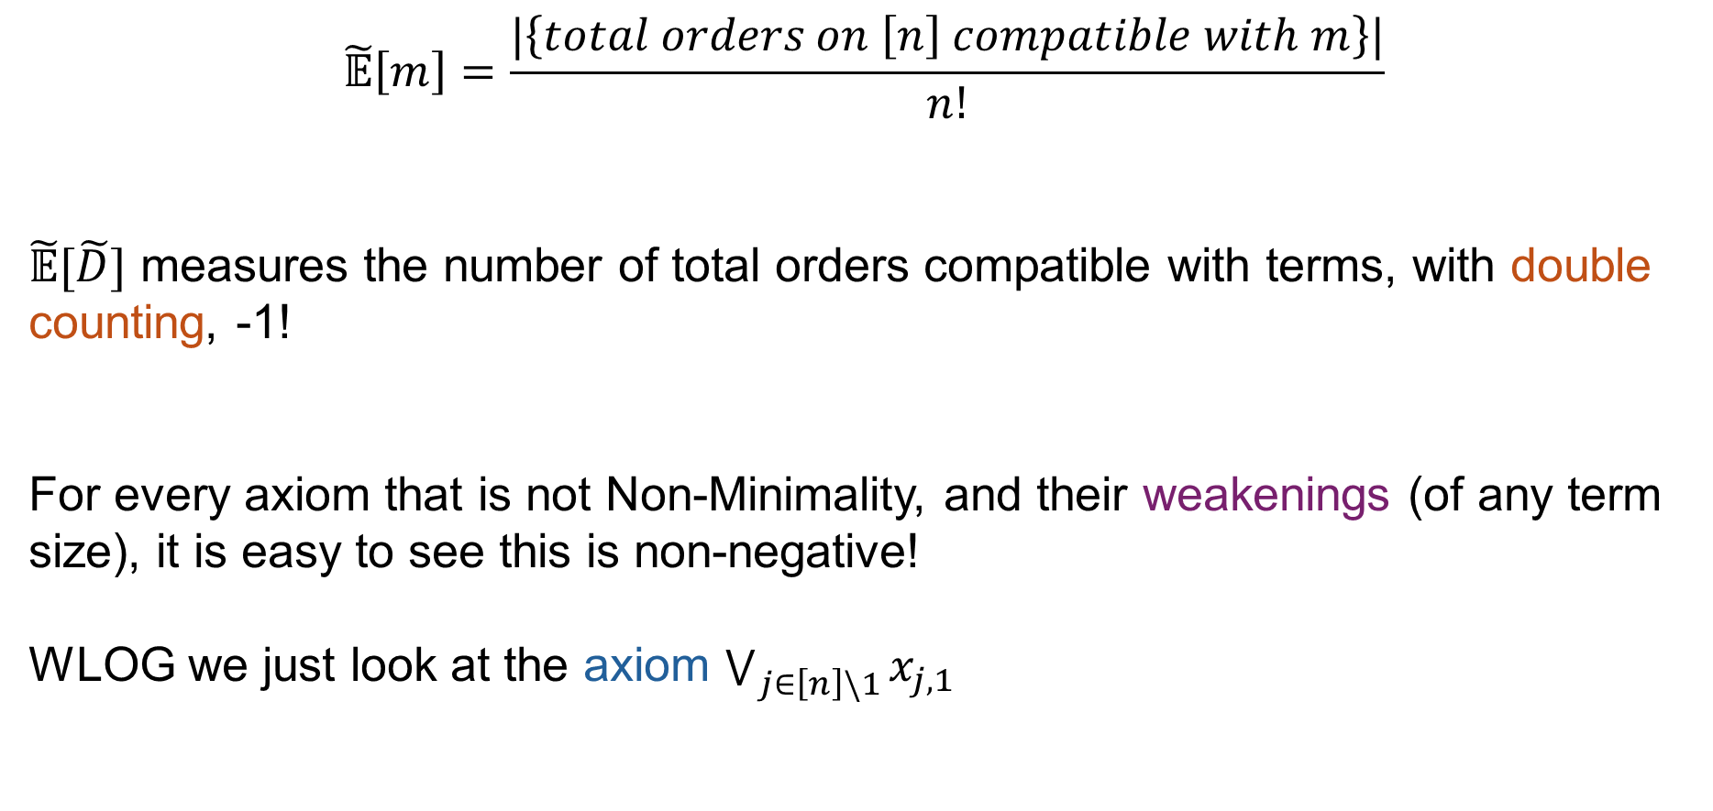
$Σ_{2}$-Pseudo-Expectation
$$\tilde{𝔼}\left[m\right]=\frac{|\left\{total orders on \left[n\right] compatible with m\right\}|}{n!}$$
$\tilde{𝔼}[\tilde{D}]$ measures the number of total orders compatible with terms, with double counting, -1!
For every axiom that is not Non-Minimality, and their weakenings (of any term size), it is easy to see this is non-negative!
WLOG we just look at the axiom $\bigvee_{j∈\left[n\right]\backslash 1}{x_{j,1}}$

Slide 23


$Σ_{2}$-Pseudo-Expectation as a Combinatorial problem
Weakenings are Coverings!
Weakening of $\bigvee_{j∈\left[n\right]\backslash 1}{x_{j,1}}$
↓
Covering of every total order on $\left[n\right]$ that does not start with 1
Tiles: terms with variables $x_{i,j}$
Example: $x_{1,2}∧x_{2,3}$ covers every order with $1≺2≺3$

Slide 24
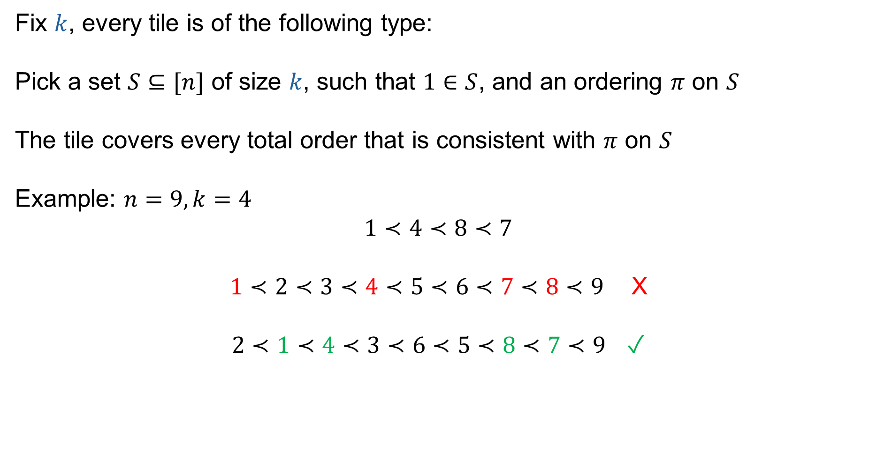
After some work: Only need to look at simpler tiles
Fix $k$, every tile is of the following type:
Pick a set $S⊆[n]$ of size $k$, such that $1∈S$, and an ordering $π$ on $S$
The tile covers every total order that is consistent with $π$ on $S$
Example: $n=9, k=4$
$1≺4≺8≺7$
$1≺2≺3≺4≺5≺6≺7≺8≺9$ X
$2≺1≺4≺3≺6≺5≺8≺7≺9$ ✓

Slide 25
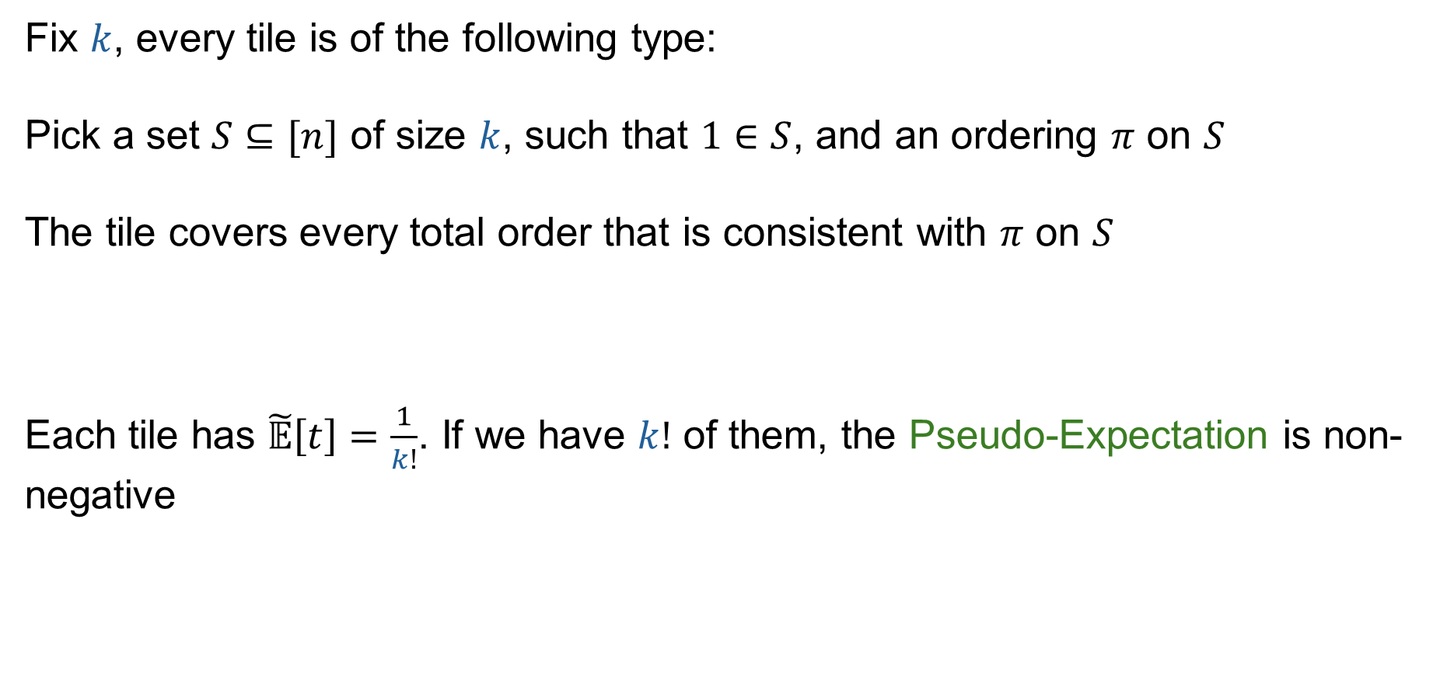
After some work: Only need to look at simpler tiles
Fix $k$, every tile is of the following type:
Pick a set $S⊆[n]$ of size $k$, such that $1∈S$, and an ordering $π$ on $S$
The tile covers every total order that is consistent with $π$ on $S$
Each tile has $\tilde{𝔼}\left[t\right]=\frac{1}{k!}$. If we have $k!$ of them, the Pseudo-Expectation is non-negative

Slide 26
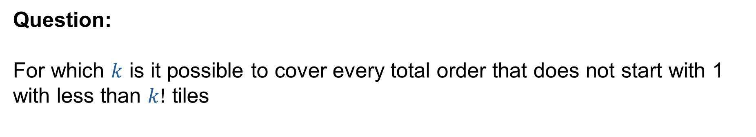
Covering problem
Question:
For which $k$ is it possible to cover every total order that does not start with 1 with less than $k!$ tiles

Slide 27
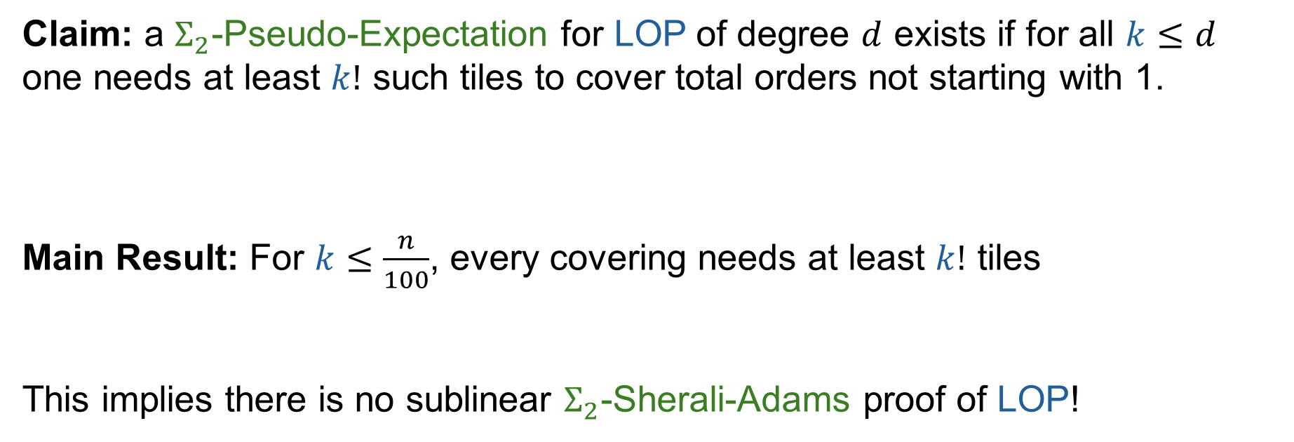
Main result (simplified)
Claim: a $Σ_{2}$-Pseudo-Expectation for LOP of degree $d$ exists if for all $k≤d$ one needs at least $k!$ such tiles to cover total orders not starting with 1.
Main Result: For $k≤\frac{n}{100}$, every covering needs at least $k!$ tiles
This implies there is no sublinear $Σ_{2}$-Sherali-Adams proof of LOP!

Slide 28
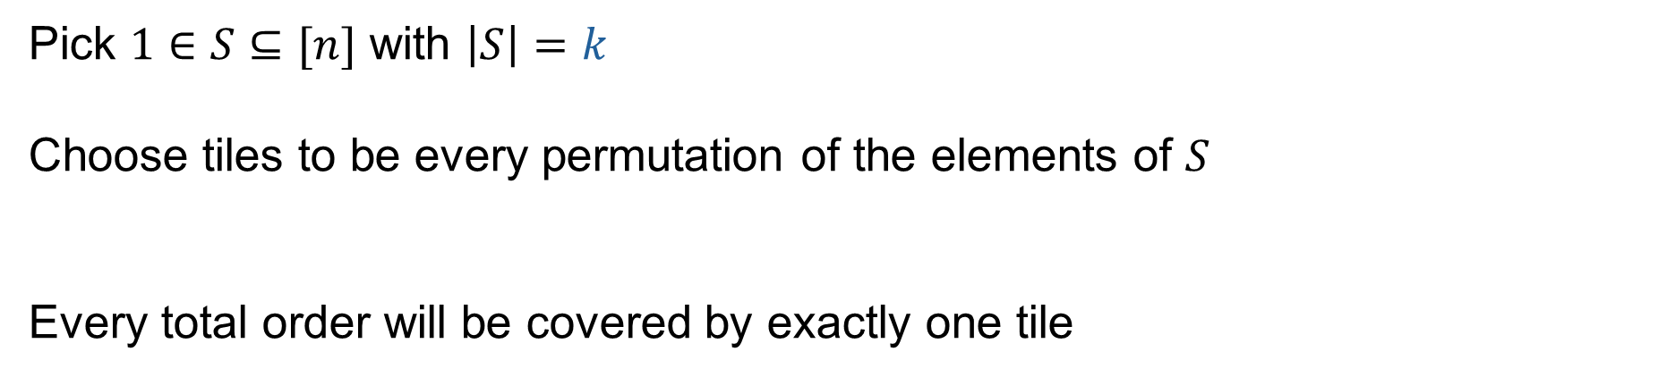
$k!$ is always enough
Pick $1∈S⊆[n]$ with $\left|S\right|=k$
Choose tiles to be every permutation of the elements of $S$
Every total order will be covered by exactly one tile

Slide 29
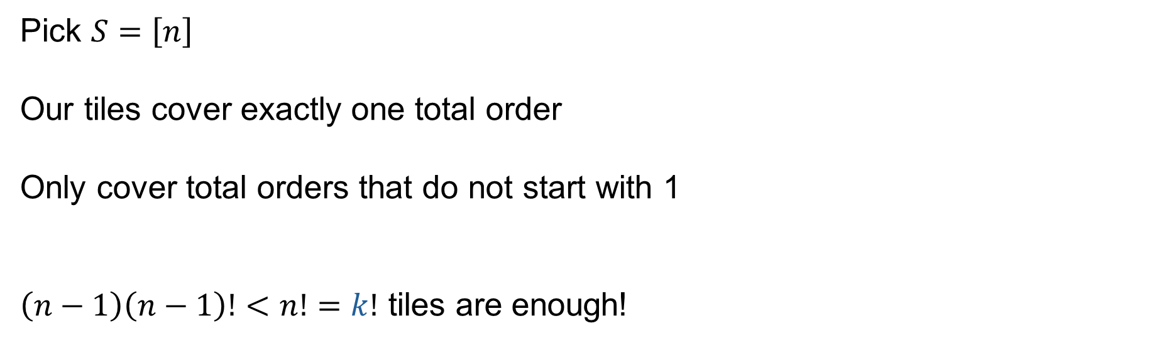
Simple bad case: $k=n$
Pick $S=\left[n\right]$
Our tiles cover exactly one total order
Only cover total orders that do not start with 1
$\left(n−1\right)\left(n−1\right)!<n!=k!$ tiles are enough!

Slide 30
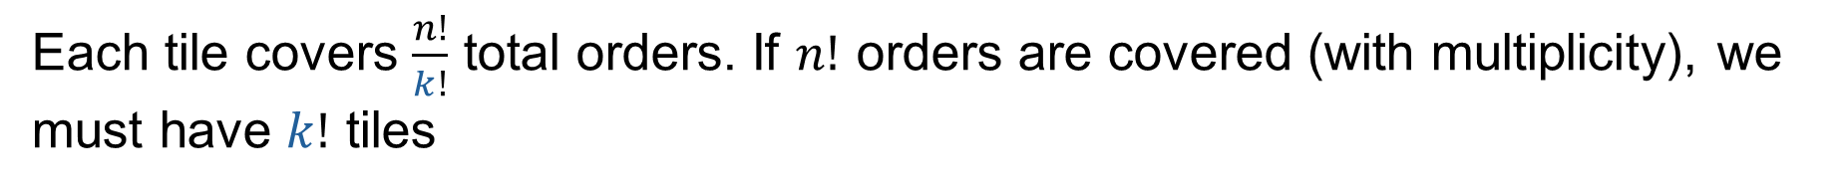
Proof sketch
Each tile covers $\frac{n!}{k!}$ total orders. If $n!$ orders are covered (with multiplicity), we must have $k!$ tiles

Slide 31


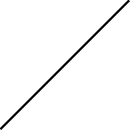
Proof sketch
Does not start with 1
Starts with 1
All total orders

Slide 32


Proof sketch
If some order is not covered → it starts with 1
Not covered

Slide 33


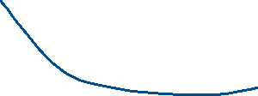

Proof sketch
We find $a,b∈\left[n\right]∖1$ such that $ab1\vec{i\{a,b\}}$, $ba1\vec{i\{a,b\}}$ must be covered twice
Not covered
Covered twice

Slide 34




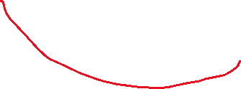
Proof sketch
Issue: There might be collisions!
Not covered
Covered twice

Slide 35
Proof sketch
Harder part of the proof: Despite collisions, there are at least as many over-covered orders as uncovered orders
Not covered
Covered twice

Slide 36
How our proof works
1. TF$Σ_{2}$ → $Σ_{2}$-Proof Complexity
LOP reduces to StrongAvoid
iff
$Σ_{2}$-(unary) Sherali-Adams can efficiently prove that LOP is total
2. Proof lower bound method
$Σ_{2}$-(unary) Sherali-Adams does not have a low degree proof of LOP
iff
There is a high degree $Σ_{2}$-Pseudo-Expectation for LOP
3. Combinatorial covering problem
We solve some covering problem that implies
there is a high degree $Σ_{2}$-Pseudo-Expectation for LOP

Slide 37
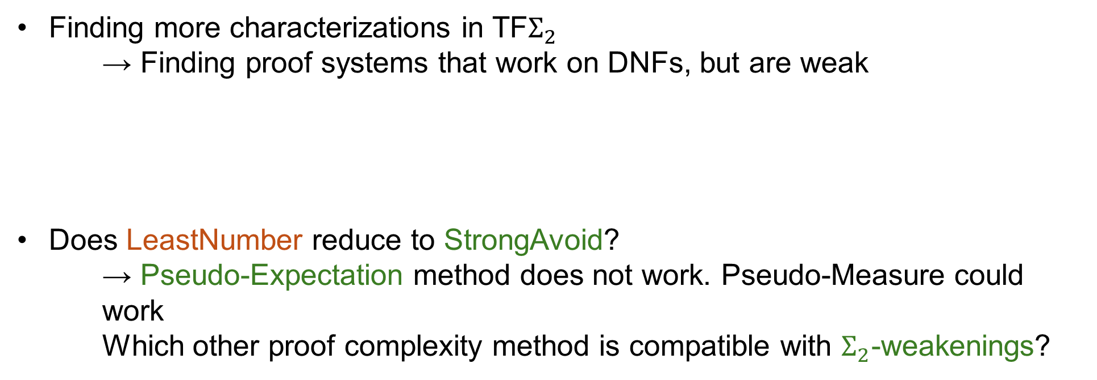
Open problems
Finding more characterizations in TF$Σ_{2}$
→ Finding proof systems that work on DNFs, but are weak
Does LeastNumber reduce to StrongAvoid?
    → Pseudo-Expectation method does not work. Pseudo-Measure could work
    Which other proof complexity method is compatible with $Σ_{2}$-weakenings?

Slide 38
Thank You!
[KP24]
[FGJ+26]

Slide 39
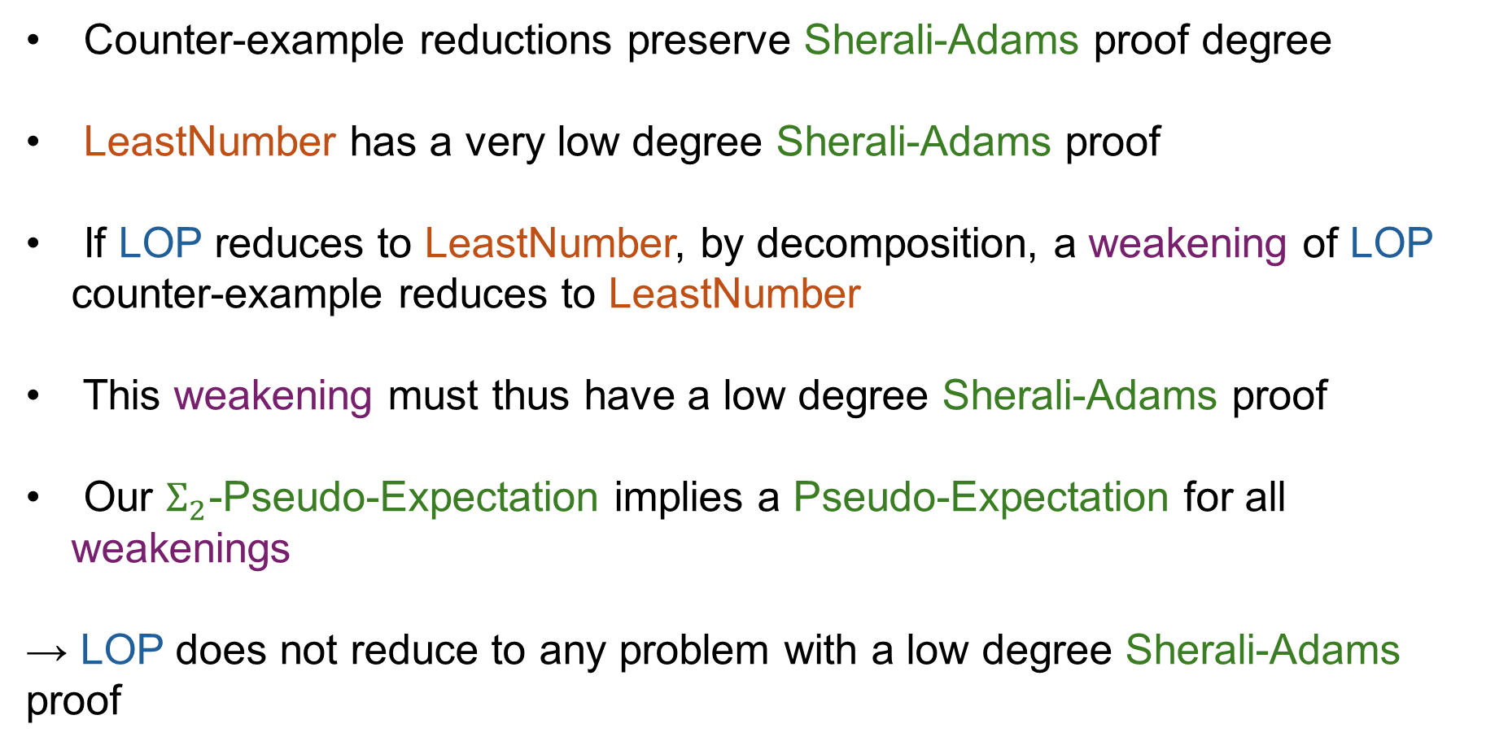
LOP does not reduce to LeastNumber
Counter-example reductions preserve Sherali-Adams proof degree
LeastNumber has a very low degree Sherali-Adams proof
If LOP reduces to LeastNumber, by decomposition, a weakening of LOP counter-example reduces to LeastNumber
This weakening must thus have a low degree Sherali-Adams proof
Our $Σ_{2}$-Pseudo-Expectation implies a Pseudo-Expectation for all weakenings
→ LOP does not reduce to any problem with a low degree Sherali-Adams proof

